Slide 1

Naeem Ur Rehman
Mobile Application Developer
at InstaCare

Slide 2
What is Dart?
Dart is a programming language designed for client development, such as for the web and mobile apps.
It is developed by Google and can also be used to build server and desktop applications.
Dart is an object-oriented, class-based, garbage-collected language with C-style syntax.

Slide 3
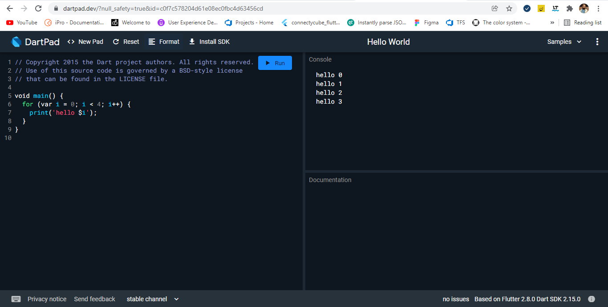
Environment (Executing Script Online with DartPad)
You may test your scripts online by using the online editor at https://dartpad.dartlang.org/

Slide 4
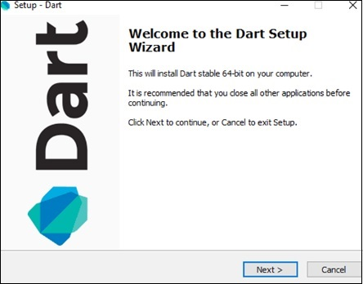
Environment (Setting Up the Local Environment)
The current stable version of Dart is 2.15.0. The dart SDK can be downloaded from − https://dart.dev/get-dart.
On completion of the SDK installation, set the PATH environment variable.
Verifying the Installation > Open cmd and type Dart.
<dart-sdk-path>\bin

Slide 5
Data Types in dart
One of the most fundamental characteristics of a programming language is the set of data types it supports. These are the type of values that can be represented and manipulated in a programming language.
The Dart language supports the following types−
Numbers
Integer
Double
Strings
Booleans
Lists
Maps
Dynamic
Dart is an optionally typed language. If the type of a variable is not explicitly specified, the variable’s type is dynamic. The dynamic keyword can also be used as a type annotation explicitly.

Slide 6
Identifiers in dart
Identifiers are names given to elements in a program like variables, functions etc. The rules for identifiers are:
Identifiers can include both, characters and digits. However, the identifier cannot begin with a digit.
Identifiers cannot include special symbols except for underscore (_) or a dollar sign ($).
Identifiers cannot be keywords.
They must be unique.
Identifiers are case-sensitive.
Identifiers cannot contain spaces.
Valid identifiers | Invalid identifiers
firstName | Var
first_name | first name
num1 | first-name
$result | 1number

Slide 7
Object-Oriented Programming in dart
Dart is an Object-Oriented language. Object Orientation is a software development paradigm that follows real-world modelling. Object Orientation considers a program as a collection of objects that communicate with each other via mechanism called methods.
Object − An object is a real-time representation of any entity.
Class − A class in terms of OOP is a blueprint for creating objects. A class encapsulates data for the object.
Method − Methods facilitate communication between objects.
class TestClass {
void print() {
print("Hello World");
}
}
void main() {
TestClass c = new TestClass();
c.print();
}

Slide 8
Variables in dart
A variable must be declared before it is used. Dart uses the var keyword to achieve the same.
All uninitialized variables have an initial value of null. This is because Dart considers all values as objects.
The dynamic keyword
var name = 'Smith’;
String name = 'Smith’;
int num = 10;
void main() {
dynamic x = "tom";
print(x);
}

Slide 9
Final and Const Variables
The final and const keyword are used to declare constants. Dart prevents modifying the values of a variable declared using the final or const keyword. These keywords can be used in conjunction with the variable’s data type or instead of the var keyword.
The const keyword is used to represent a compile-time constant. Variables declared using the const keyword are implicitly final.
final variable_name;
OR
final data_type variable_name;
const variable_name;
Or
const data_type variable_name;

Slide 10
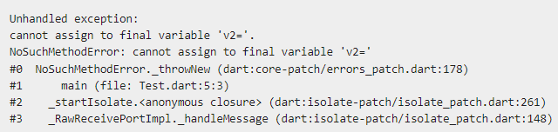
Question!
void main() {
final v1 = 12;
const v2 = 13;
v2 = 12;
}

Slide 11
Dart Operators
An operator is a special symbol that is used to carry out some specific operation on its operand. In Dart, we have rich set of built in operators to carry out different type of operations. In Dart, we have following types of operators available:
Assignment Operators
Arithmetic Operators
Type test Operators
Relational Operators
Logical Operators
Bitwise Operators
Conditional Operators
Casecade notation(..) Operator

Slide 12
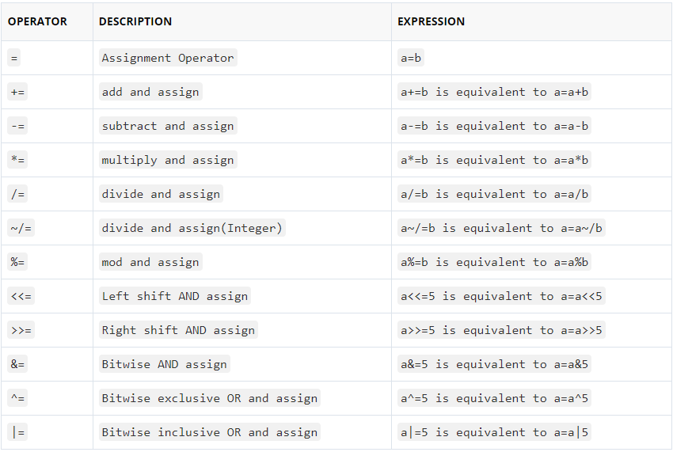
Dart Assignment Operators

Slide 13
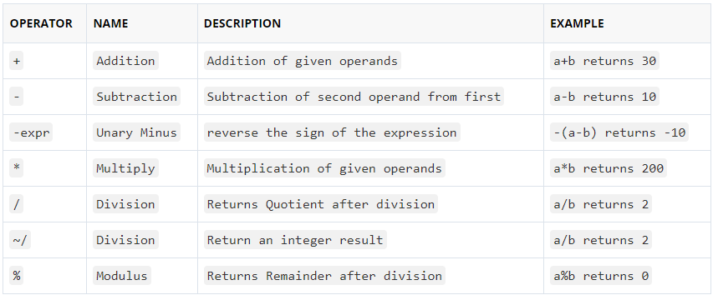
Dart Arithmetic Operators
Let variable a holds 20 and variable b holds 10:

Slide 14
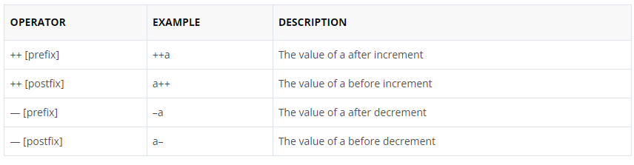
Dart Unary Operators (post and pre)
In Java, ++ and — are know as increment and decrement operators respectively. These are unary operators it means they works on single operand. ++ adds 1 to operand and — subtracts 1 to operand respectively. When ++ is used as prefix(like: ++i), ++i will increment the value of i and then return it but, if ++ is used as postfix(like: i++), operator will return the value of operand first and then only increment it.

Slide 15
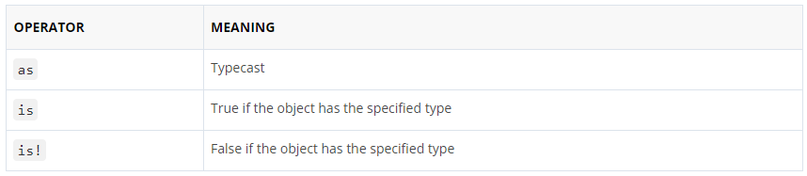
Dart Type test Operators
The Type test operators are used for checking types at runtime.

Slide 16
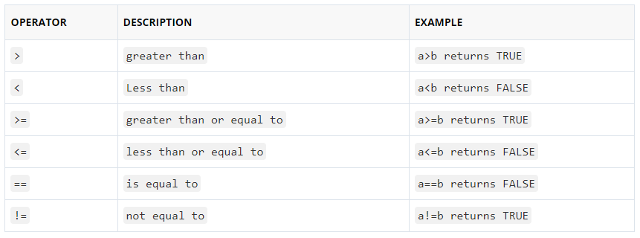
Dart Relational Operators
Let variable a holds 20 and variable b holds 10, then −

Slide 17
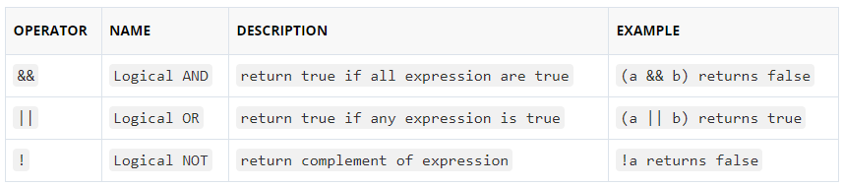
Dart Logical Operators
Let variable a holds true or 1 and variable b holds false or 0, then −

Slide 18
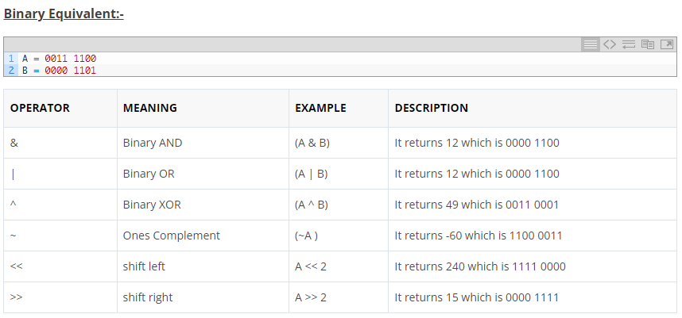
Dart Bitwise Operators
Bitwise operator are used to perform bit level operation over its operand. Let A = 60; and B = 13;

Slide 19
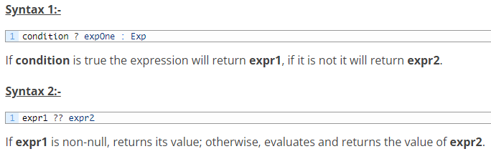
Dart Conditional Operators ( ? : )
The conditional operator is considered as short hand for if-else statement. Conditional operator is also called as “Ternary Operator”.

Slide 20
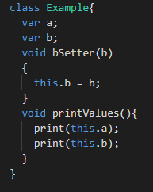
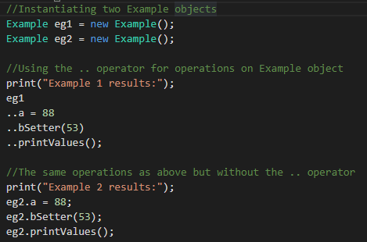
Dart Cascade notation(..) Operator
Cascades (..) allow you to perform a sequence of operations on the same object. The Cascades notation(..) is similar to method chaining that saves you number of steps and need of temporary variable.

Slide 21
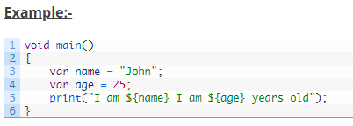

String Interpolation
String interpolation is the process of evaluating a string containing placeholders, variables and interpolated expressions. When an interpolated string is evaluated the placeholders, variables and expressions are replaced with their corresponding values. In Dart, ${expression} is used for string interpolation.

Slide 22
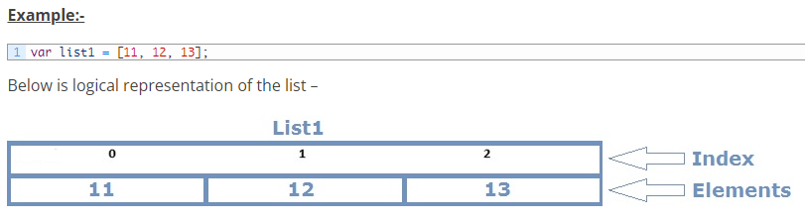
Dart Lists
In Dart, list data type is used to represent a collection of objects. A List is an ordered group of objects. The List data type is actually similar to the concept of an array in other programming languages

Slide 23
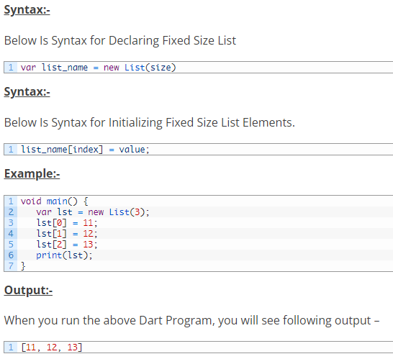
Fixed Length List
A List object declared with size specified cannot be changed runtime.

Slide 24
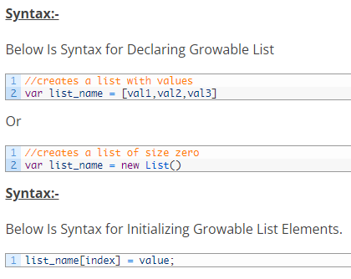
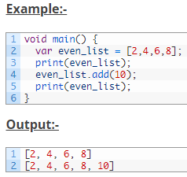
Growable List
A List object declared without size is termed as Growable List. The length of the growable list can changed in runtime.

Slide 25
Dart Map
The Map is an object that is used to represents a set of values as key-value pairs. In Map, both keys and values can be of any type of object, it is not necessary that the keys and values both of the same type.. In Map, each key can only occurs once, but the same value can be used multiple times. In Map, each of the value is associated with a unique key, and this key is used to accessed corresponding Map value. The Map can be defined by using curly braces ({ }) and values can be assigned and accessed using square braces ([]).

Slide 26
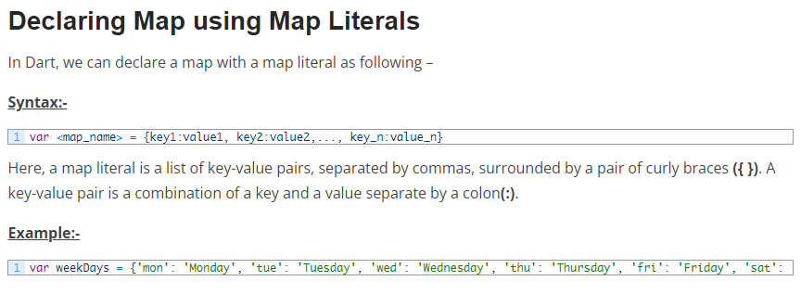
Declaring Map In Dart
In Dart, Maps can be declared in following two ways –
Using Map Literals
Using a Map constructor

Slide 27
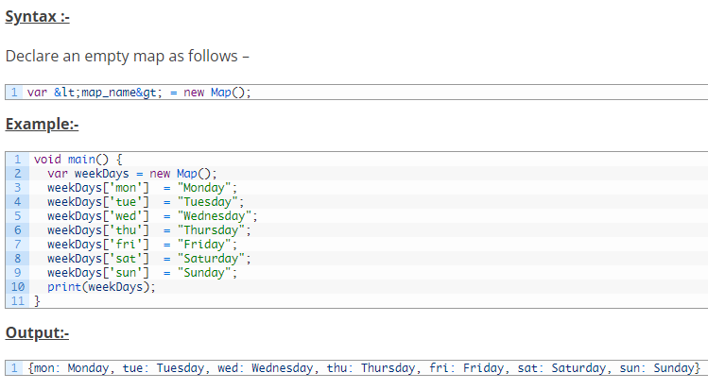
Declaring/Initialize Map using Map Constructor
In Dart, we can declare/initialize a map with a map constructor as following

Slide 28
Decision Making Statements
There are case where we want a block of code to be executed when some condition is satisfied. In Dart, we have rich set of Decision Making Statement that enable computer to decide which block of code to be execute based on some conditional choices. Decision making statement evaluates single or multiple test expressions which results is “TRUE” or “FALSE”. The outcome of the test expression/condition helps to determine which block of statement(s) to executed if the condition is “TRUE” or “FALSE” otherwise. In Dart, we have following decision making statements –
Dart if Statements
Dart If else Statements
Dart if else if Statements
Dart Switch Case Statement

Slide 29
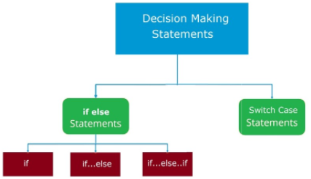
Decision Making Statements diagram

Slide 30
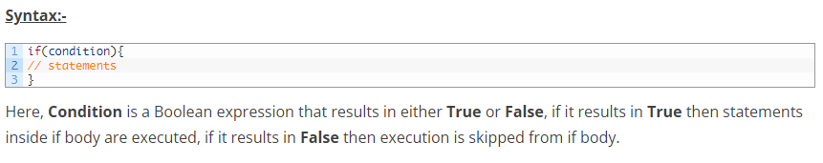
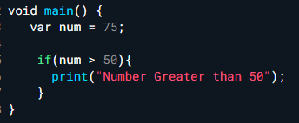

Dart If Statement
If statement allows a block of code to be executed only when a specified condition is true. An if statement evaluates a boolean expression followed by one or more statements. The given boolean expression results in a boolean value that can only be either true or false.

Slide 31
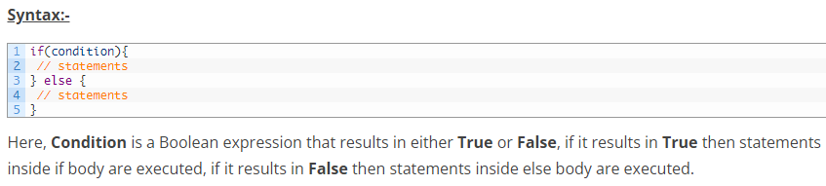
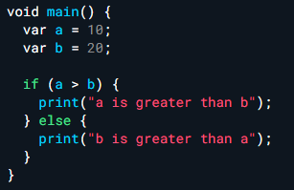

Dart If Else Statement
In Dart, when we want to execute a block of code when if condition is true and another block of code when if condition is false, In such a case we use if…else statement.

Slide 32
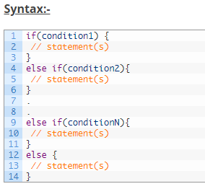
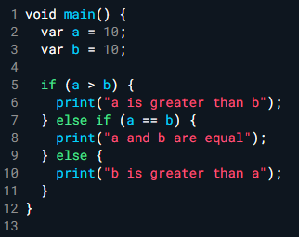

Dart If Else If Statement
When we want to add multiple condition checks in single if else statement then by using if else-if else statement we can easily add multiple conditions. In Java, if..else..if statement allows us add alternative set of test conditions in if..else statement using else-if and single else statements for if condition. In such way if..else..if statement is used to select one among several blocks of code to be executed.

Slide 33
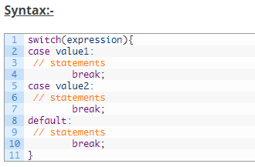
Dart Switch Case Statement
In Dart, switch case statement is simplified form of the Nested if else statement , it helps to avoid long chain of if..else if..else statements. A switch case statement evaluates an expression against multiple cases in order to identify the block of code to be executed.

Slide 34
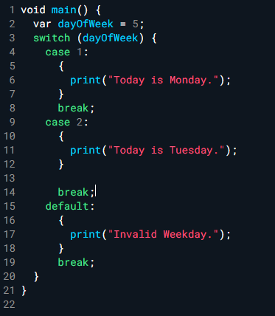

Dart Switch Case Statement Example

Slide 35
Dart Loops
Loop statements are used to execute the block of code repeatedly for a specified number of times or until it meets a specified condition. Loop statement are very useful to iterate over collection/list of items or to perform a task for multiple times.
In Dart, we have following loop statements available-
Dart for loop
Dart for…in loop
Dart while loop
Dart do while loop

Slide 36
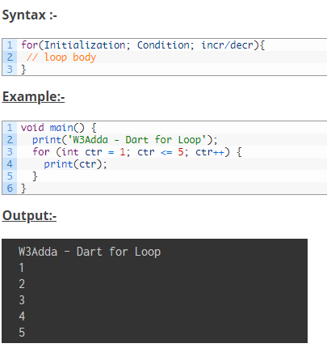
Dart for Loop

Slide 37
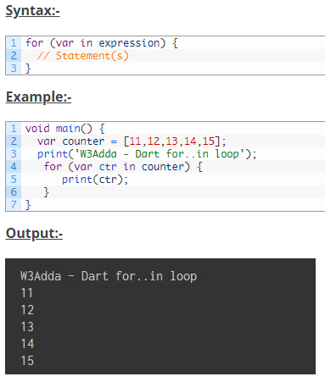
Dart for..in (for-each in java) Loop

Slide 38
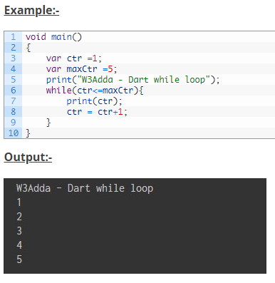
Dart While Loop

Slide 39
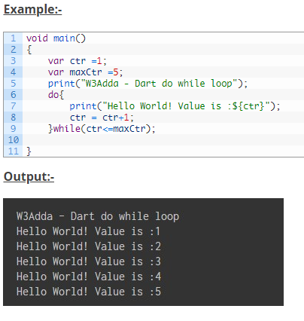
Dart do…while Loop

Slide 40
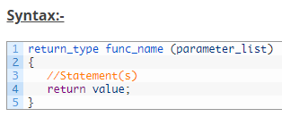
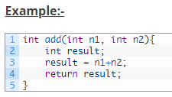
Defining a function In Dart

Slide 41
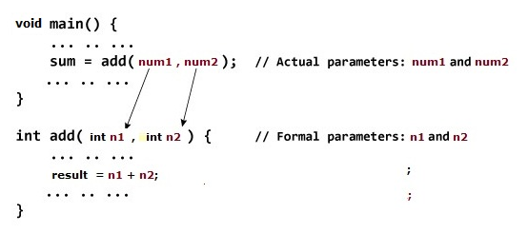
Dart Passing Arguments to Function

Slide 42
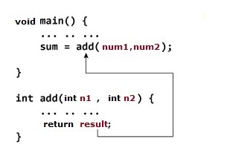
Return Value from Function

Slide 43
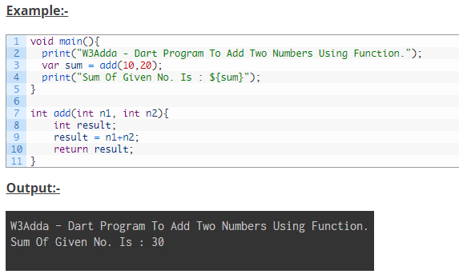
Complete Function In Action

Slide 44
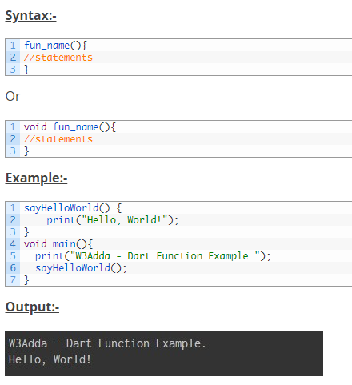
Dart function without Parameters and Without Return value

Slide 45

Optional Positional Parameter
Optional positional parameters can be specified by having individual parameter separated by commas and enclosed within square brackets ([]). Calling a function having optional positional parameters defined may specify a variable number of arguments.

Slide 46
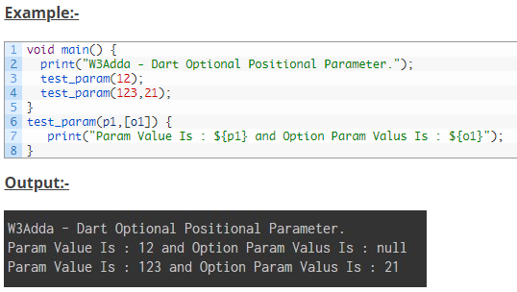
Optional Positional Parameter

Slide 47
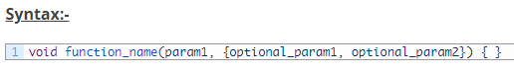
Optional named parameter
Named positional parameters can be specified by having individual parameter name separated by commas and enclosed within curly brackets ({ }).

Slide 48
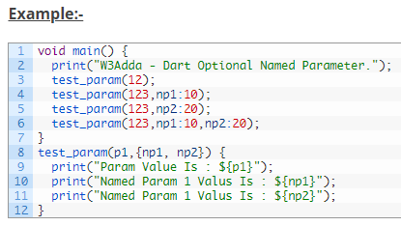
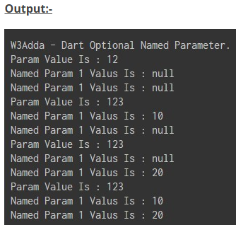
Optional named parameter
Calling a function having optional named parameters, the individual parameter’s name must be specified while the value is being passed. Names are specified using parameter:value. The sequence of passing the parameter(s) does not matter.

Slide 49

Dart Anonymous Functions
In Dart, most of the functions we have seen are named functions; we can also create nameless function knows as anonymous function, lambda or closure. An anonymous function is like named function but they do not have name associated with it. An anonymous function can have zero or more parameters with optional type annotations.
An anonymous functions consists of self-contained blocks of code and that can passed around in our code as a function parameters. In Dart, we can assign an anonymous function to constants or variables, later we can access or retrieve the value of closure based on our requirements.

Slide 50
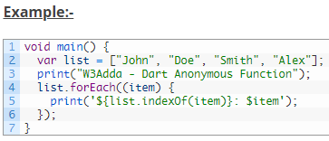
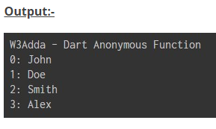
Dart Anonymous Functions - Example
The bellow example defines an anonymous function with an untyped parameter, item. The function, invoked for each item in the list, prints a string that includes the value at the specified index. When we run the above Dart program, we will see following output.

Slide 51
Dart main() Function
This is the most vital part of each and every Dart program, it is mandatory for every Dart program to have a top-level main() function definition. There can be only one main() function in Dart program. It serves as the entry point for every Dart program or app; the execution of a Dart program or application starts with the main() function. The Dart program can not be executed without the main() function. The main() function is responsible for the execution of all the user defined statement, functions and library functions. The main() function further structured into variable declaration, function declaration and user defined executable statements. The main() function returns void and can have an optional List<String> parameter as arguments. Below is the general syntax of a typical main() function.

Slide 52
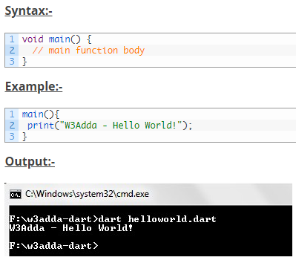
Dart main() Function - Example

Slide 53
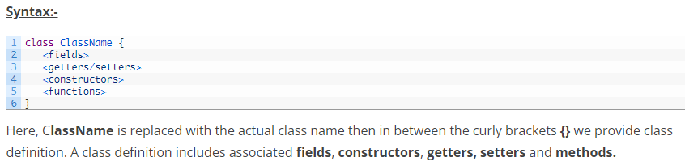
Dart Classes
In Dart, a class can be defined using the class keyword followed by the class name; and the class body enclosed by a pair of curly braces ({}).

Slide 54
Dart Constructors
The Constructor name should be the same name as the class name. Suppose if we have class Test, then the constructors name should also be Test.
The Constructor cannot have a explicit return type.
There are following type of Constructors in Dart, they are
Default Constructor (or) no-arg Constructor
Parameterized Constructor
Named Constructor

Slide 55
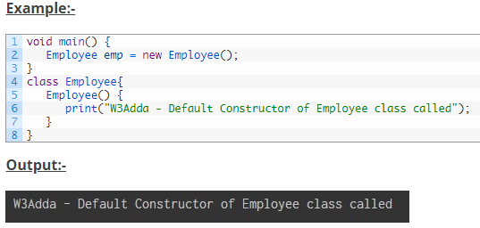
Default Constructor (or) no-arg constructor
If you don’t create any constructor for a class, the compiler will automatically creates a default constructor(with no arguments) for the class

Slide 56
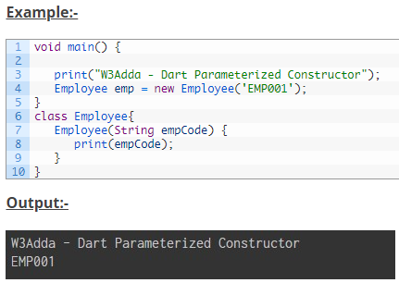
Parameterized Constructor
Constructors can also take parameters, which is used to initialize instance variables. Most often, we will need a constructor that accepts one or more parameters.

Slide 57

Named constructors
In Dart, named constructors allows a class to define multiple constructors.

Slide 58
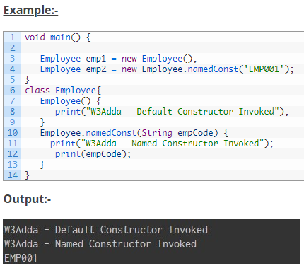
Named constructors - example

Slide 59
Dart Getters and Setters
Getters and setters are special class methods that is used to initialize and retrieve the values of class fields respectively. The setter method is used to set or initialize respective class fields, while the getter method is used to retrieve respective class fields. All classes have default getter and setter method associated with it. However, you are free to override the default ones by implementing the getter and setter method explicitly.

Slide 60

Defining a getter
The getters are defined using the get keyword with no parameters and returns a value.

Slide 61

Defining a setter
The setters are defined using the set keyword with one parameter and no return value.

Slide 62



Getter setter example
The following example shows how you can use getters and setters in a Dart class –

Slide 63
Dart this Keyword
The this keyword represents an implicit object pointing to current class object. It refers to the current instance of the class in a method or constructor. The this keyword is mainly used to eliminate the ambiguity between class attributes and parameters with the same name. When the class attributes and the parameter name are same; this keyword is used to avoid ambiguity by prefixing class attributes with the this keyword. The this keyword can be used to refer to any member of the current object from within an instance method or a constructor. Uses Of this Keyword
It can be used to refer instance variable of current class
It can be used to invoke or initiate current class constructor
It can be passed as an argument in the method call
It can be passed as argument in the constructor call
It can be used to invoke current class method
It can be used to return the current class instance

Slide 64

Dart this Keyword - example

Slide 65
Dart static Keyword
The static keyword is used for memory management of global data members. The static keyword can be applied to the fields and methods of a class. The static variables and methods are part of the class instead of a specific instance. The static keyword is used for a class level variable and method that is the same for every instance of a class; this means if you make a data member static, you can access it without creating a object. The static keyword allows data members to persist values between different instances of a class. There is no need to create a class object to access a static variable or call a static method; simply put the class name before the static variable or method name to use them.

Slide 66


Dart static Keyword - example

Slide 67

Dart super Keyword
The super keyword is a reference variable which is used to refer immediate parent class object. It is used to refer the superclass properties and methods. This is possible because when we create an instance of subclass, an instance of its parent class is created implicitly which we can refer using the super keyword. The most common use of the super keyword is to eliminate the ambiguity between superclasses and subclasses that have variables and methods with the same name.

Slide 68


Dart super Keyword - example

